Slide 1
Software Engineering Unit-V
Prepared by: Neha Tripathi

Slide 2
Computer Aided Software Engineering(CASE)

Slide 3
CASE Tool and its scope
A CASE (Computer Aided Software Engineering) tool is a generic term used to denote any form of automated support for software engineering.
In a more restrictive sense, a CASE tool means any tool used to automate some activity associated with software development.
Many CASE tools are available. Some of these CASE tools assist in phase related tasks such as specification, structured analysis, design, coding, testing, etc.; and others to non-phase activities such as project management and configuration management.
The primary reasons for using a CASE tool are:
• To increase productivity
• To help produce better quality software at lower cost

Slide 4
CASE Environment
Although individual CASE tools are useful, the true power of a tool set can be realized only when these set of tools are integrated into a common framework or environment.
CASE tools are characterized by the stage or stages of software development life cycle on which they focus.
Since different tools covering different stages share common information, it is required that they integrate through some central repository to have a consistent view of information associated with the software development artifacts.
This central repository is usually a data dictionary containing the definition of all composite and elementary data items.
Through the central repository all the CASE tools in a CASE environment share common information among themselves.
Thus a CASE environment facilities the automation of the step-by-step methodologies for software development.
A schematic representation of a CASE environment is shown in fig.

Slide 5
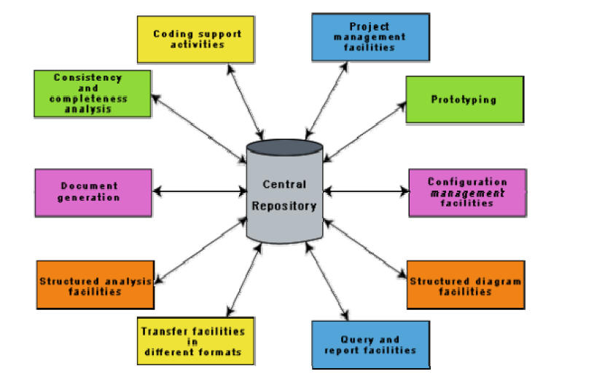
CASE Environment

Slide 6
CASE environment vs programming environment
A CASE environment facilitates the automation of the step-by-step methodologies for software development.
In contrast to a CASE environment, a programming environment is an integrated collection of tools to support only the coding phase of software development.

Slide 7
Benefits of CASE
A key benefit arising out of the use of a CASE environment is cost saving through all development phases. Different studies carry out to measure the impact of CASE put the effort reduction between 30% to 40%.
Use of CASE tools leads to considerable improvements to quality. This is mainly due to the facts that one can effortlessly iterate through the different phases of software development and the chances of human error are considerably reduced.
CASE tools help produce high quality and consistent documents. Since the important data relating to a software product are maintained in a central repository, redundancy in the stored data is reduced and therefore chances of inconsistent documentation is reduced to a great extent.

Slide 8
CASE tools take out most of the drudgery in a software engineer’s work. For example, they need not check meticulously the balancing of the DFDs but can do it effortlessly through the press of a button.
CASE tools have led to revolutionary cost saving in software maintenance efforts. This arises not only due to the tremendous value of a CASE environment in traceability and consistency checks, but also due to the systematic information capture during the various phases of software development as a result of adhering to a CASE environment.
Introduction of a CASE environment has an impact on the style of working of a company, and makes it oriented towards the structured and orderly approach.

Slide 9
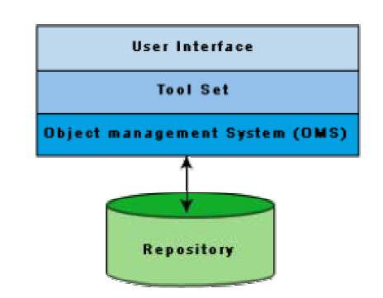
Architecture of a CASE environment

Slide 10
User Interface
The user interface provides a consistent framework for accessing the different tools thus making it easier for the users to interact with the different tools and reducing the overhead of learning how the different tools are used.
Object Management System (OMS) and Repository
Different case tools represent the software product as a set of entities such as specification, design, text data, project plan, etc. The object management system maps these logical entities such into the underlying storage management system (repository). The commercial relational database management systems are geared towards supporting large volumes of information structured as simple relatively short records. There are a few types of entities but large number of instances. By contrast, CASE tools create a large number of entity and relation types with perhaps a few instances of each. Thus the object management system takes care of appropriately mapping into the underlying storage management system.

Slide 11
Thank you!

